Slide 1
RPA Automation - Morning files Routine with Power Automate Desktop
By Bruno Tortola
https://www.linkedin.com/in/brunotortola/
brunohtortola@gmail.com

Slide 2



Files Routine with Power Automate Desktop
This presentation will show a flow I built using Power Automate Desktop (PAD), to automate the process of downloading, moving, manipulating and modifying files, folders and emails

Slide 3
What is RPA?
RPA stands for Robotic Process Automation, and is a growing field in data science and administrative process in general.
The goal is to write scripts that perform repetitive tasks, such as downloading an attachment, saving to a cloud or running a macro
The script can be wrote in a such a way to concatenate the actions, each process being a pre-requisite of a previous one.
Scripting repetitive process saves work hours, which reflect on the company paid worktime.
It also increases productivity and reduce errors, since the script is performing the task a human would.

Slide 4
Technologies used
Excel
Sharepoint
Power Automate Desktop
VBA
Macros
Outlook
Power Query

Slide 5
Disclaimers
In order to preserve critical information of the company, some data had to be blanked out.
For the same reason, the original .scripts cannot be shared, so I’m presenting it in PowerPoint format instead.

Slide 6
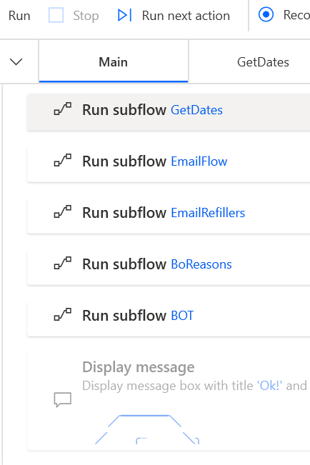
Flow Structure
We can see of the left the main screen of the flow. Each subflow contains a different script that runs many command lines.
In the next slides I’m going to further explain each one.
Since the codes can be very big, on the images is shown only excerpts of the script.

Slide 7

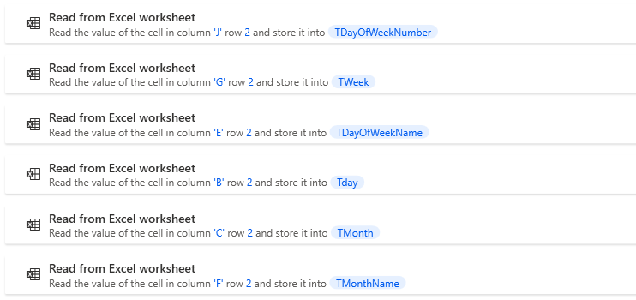
GetDates flow
First, we need to know which day it is, so we can name the files and arrange them accordingly. So this part of the flow opens an Excel spreadsheet and read data from it, to make it easier to identify, the week day, week day name, week number, and many others

Slide 8

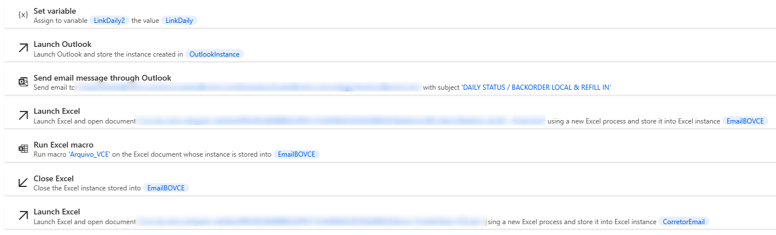
EmailFlow
This flows sends an automated email to stakeholders, reminding them to fill in a file.
Afterwards, it opens and runs an Excel Macro, then closes the file.

Slide 9

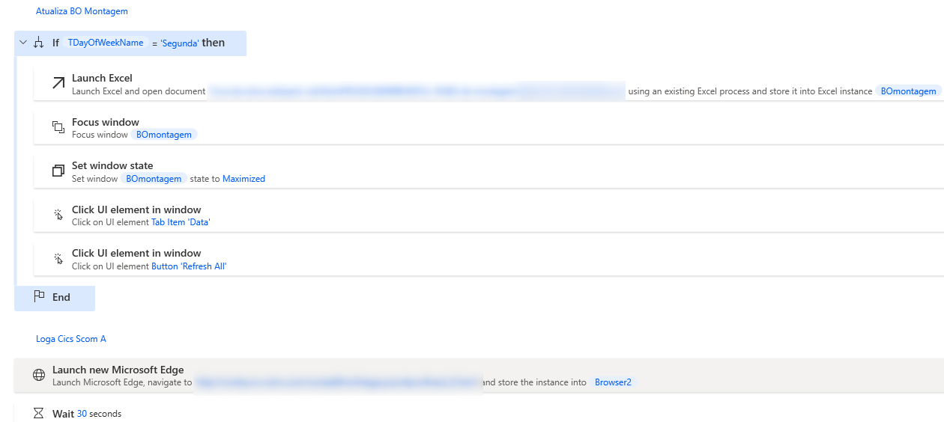
EmailRefillers
This is one is a lot more complex. First it takes my username and password as variables, and stores is. Then opens up a WMS (Warehouse Management System) and logs in using my credentials.
After that, it opens up two Excel files and run macros within them, that are connected to the WMS system. The macros then take the data from the WMS and writes it to the spreadsheets

Slide 10

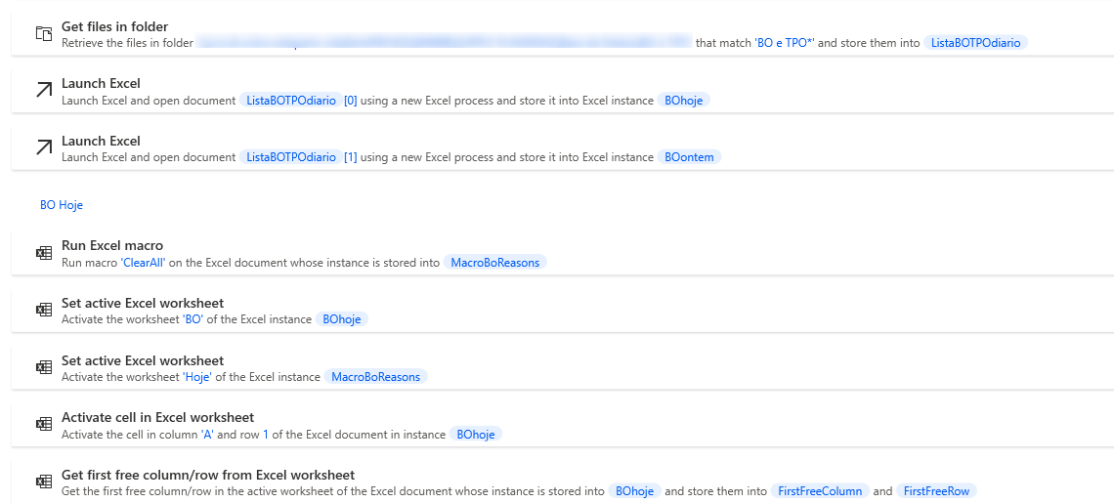
BoReasons
This flow takes two files, the one generated today and yesterdays, and power automate copies the data within them.
This data is then pasted to a third excel file with a macro, that runs and generates a report that is sent by email with the consolidated data.

Slide 11

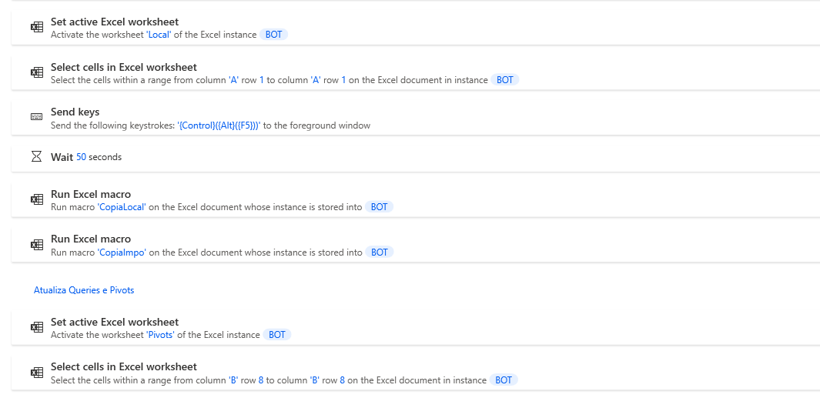
BOT
This flow involves not only macros, but alos pivot tables and power query.
First, an Excel spreadsheet is open, and data from the previous day is stored in a separate tab.
Then the PAD types in the following keys {Control}({Alt}({F5})), triggering in the Power Query connection within the file and the pivot tables to update.
Next, a Macro is run to copy the data from today in comparison with yesterdays, and an email is sent to the stakeholders to fill in the new data for the day.

Slide 12
Conclusion

Slide 13
Conclusion
The whole automated flow takes 8 minutes to run, instead of the 16 minutes it took to run it manually.
Not only is it faster, but also negates the possibility of human errors, very common to this kinds of tasks
Moreover, 8 minutes a day saved, when calculating the benefits, equates to around 53k reais (or 10k dollars) saved in work time hours.
This type of automation can be applied to many different process, and is in great demand in the market.
PAD is also part of the Power Platform by Microsoft, and can be integrated to PowerBI Power Apps, Power Virtual Agents and Power Automate Web

Slide 14
Thanks for checking out my work!
Lets connect on LinkedIn!
https://www.linkedin.com/in/brunotortola/
brunohtortola@gmail.com

